Slide 1
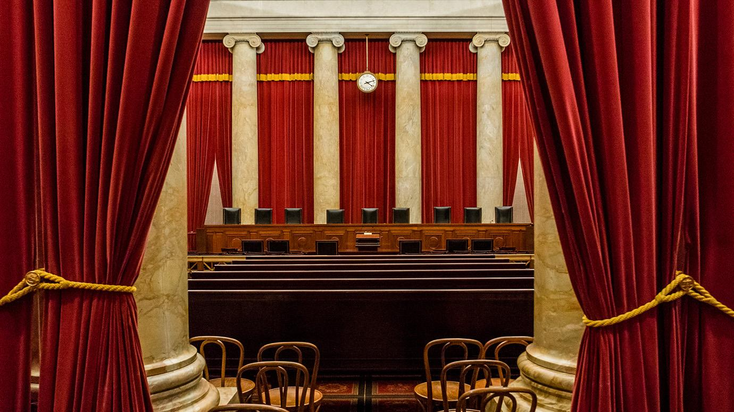
Model Rulings of the United States Supreme Court
Mirella Mardakis, Erica Leon, Emily Tavik

Slide 2
Oyez.
Oyez.
Oyez.
All persons having business before the Honorable, the Supreme Court of the United States, are admonished to draw near and give their attention, for the Court is now sitting. God save the United States and this Honorable Court.

Slide 3
Objectives
Collect data regarding on individual Supreme Court Justice votes
Supreme Court Database (via Washington University Law)
Create a model based on the activity of each Justice in the 2017 term.
Understand and predict how each Justice would vote based on the input data
Use the prediction model to analyze how the 2017 term would have voted on historical, landmark cases.
Brown v The Board of Education (1954) | Gideon v Wainwright (1963)
Mapp v Ohio (1961) | Miranda v Arizona (1966)
New Jersey v T.L.O. (1985) | Regents of the University of California v Bakke (1978)
Roe v Wade (1973) | Texas v Johnson (1989)
Tinker v Des Moines (1969) | US v Nixon (1974)
Term
Precedent Alteration
Issue Area
Law Type
Case State Origin
Brown v The Board of Education (1954)
Gideon v Wainwright (1963)
Hazelwood v Kuhlmeier
Mapp v Ohio (1961)
Miranda v Arizona (1966)
New Jersey v T.L.O. (1985)
Roe v Wade (1973)
Texas v Johnson (1989)
Regents of the University of California v Bakke (1978)
Tinker v Des Moines (1969)
US v Nixon (1974)

Slide 4
Method
Python used in Jupyter Notebook to clean data, export csv(s) and build/train our machine.
Tableau was used to visualize the full data for the 8 Justices in our model as well as the Court’s full rulings from 1949 – 2017.
Model information >>>
Sci-Kit Learn
An html script was written to view the collected information,

Slide 5
Mitigating Factors in Ruling Analysis
Thousands of parties petition the Court each year. Cases need a 4/9 vote to be heard. The Court typically hears oral arguments on about 80 cases.
Often, denying to hear a case implies siding with the lower Court’s ruling. These cases cannot be factored into the model.
Theories of Constitutional Interpretation (often viewed as ‘liberal’ or ‘conservative’)
Originalism
Textualism
Non-Originalist (Living Constitutionalism)
Precedent Alterations
Much of an individual Justice's constitutional interpretation involves willingness to rule against precedent. This isn’t a factor that can be measured or coded as ‘liberal’ or ‘conservative’.

Slide 6
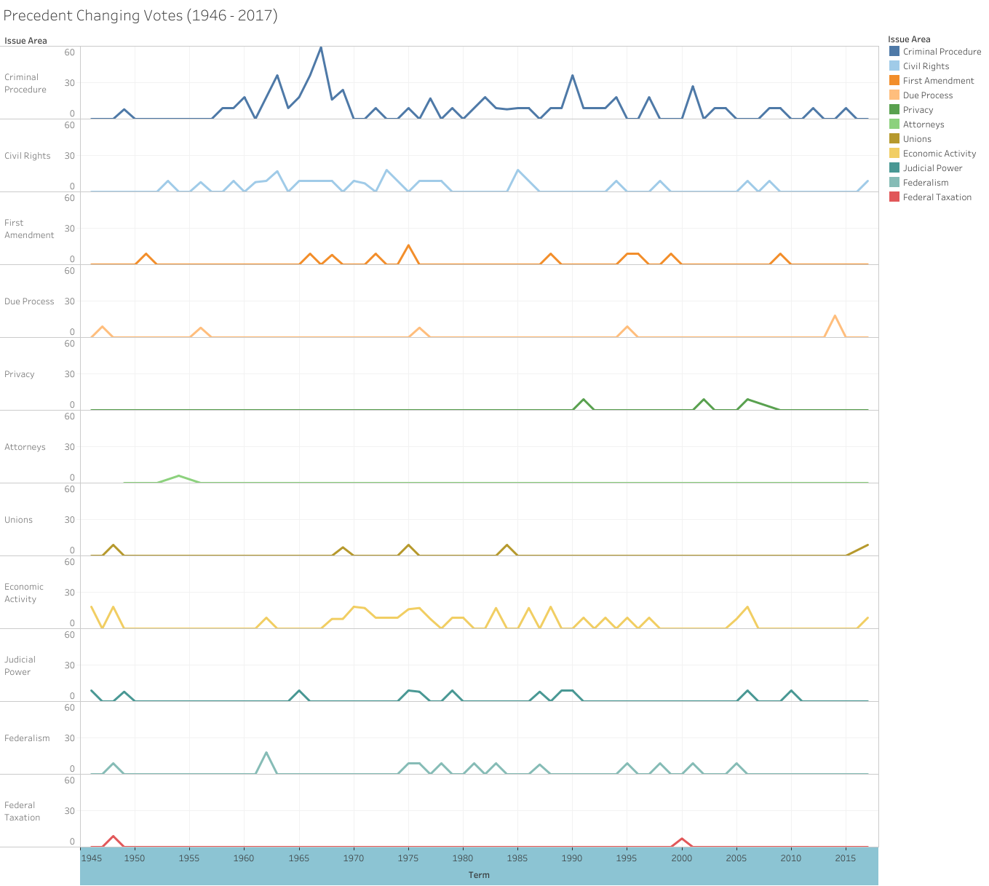
Criminal Procedure has the highest rate of precedent change and the greatest number of overall changes were made in the 1960’s.
All precedent changing votes are trending down over the last 70 years.

Slide 7
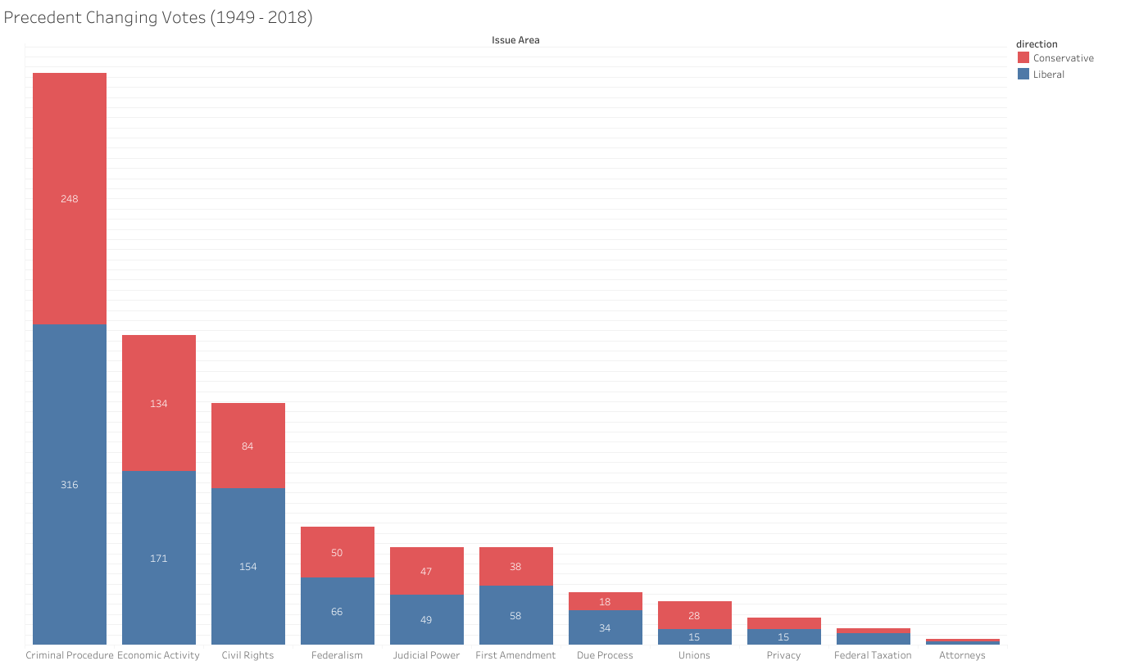
Votes that changed precedents 1949 - 2017

Slide 8
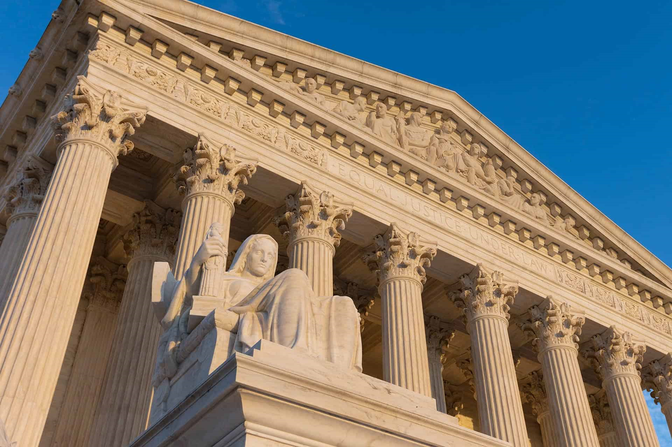
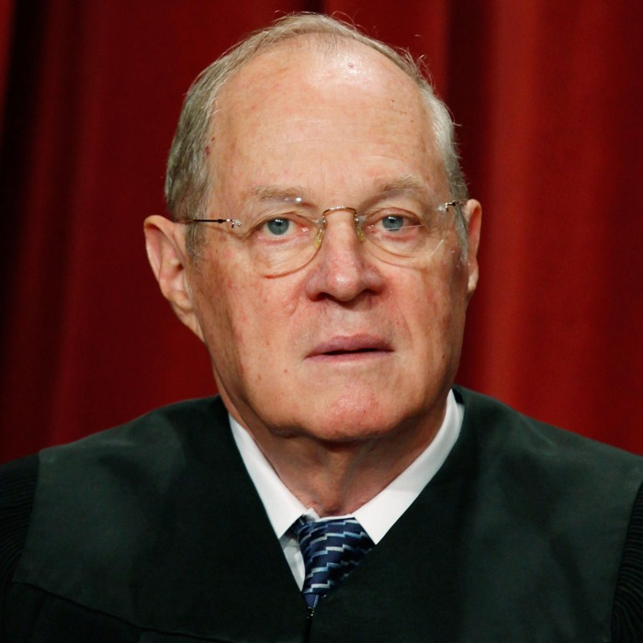
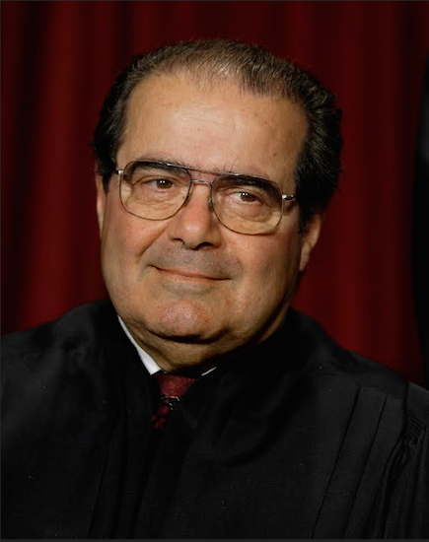
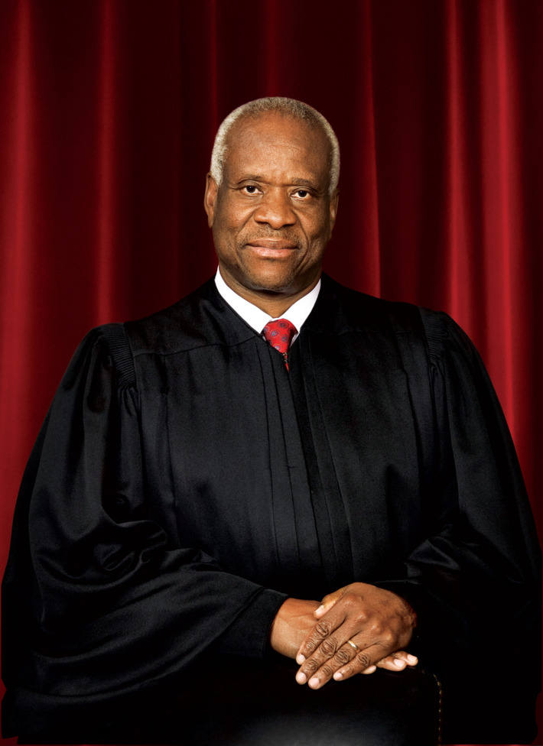
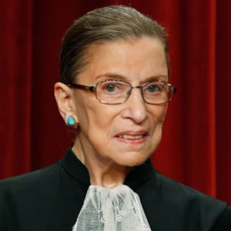
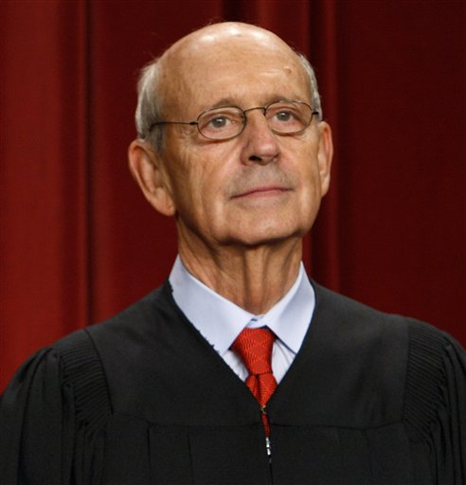
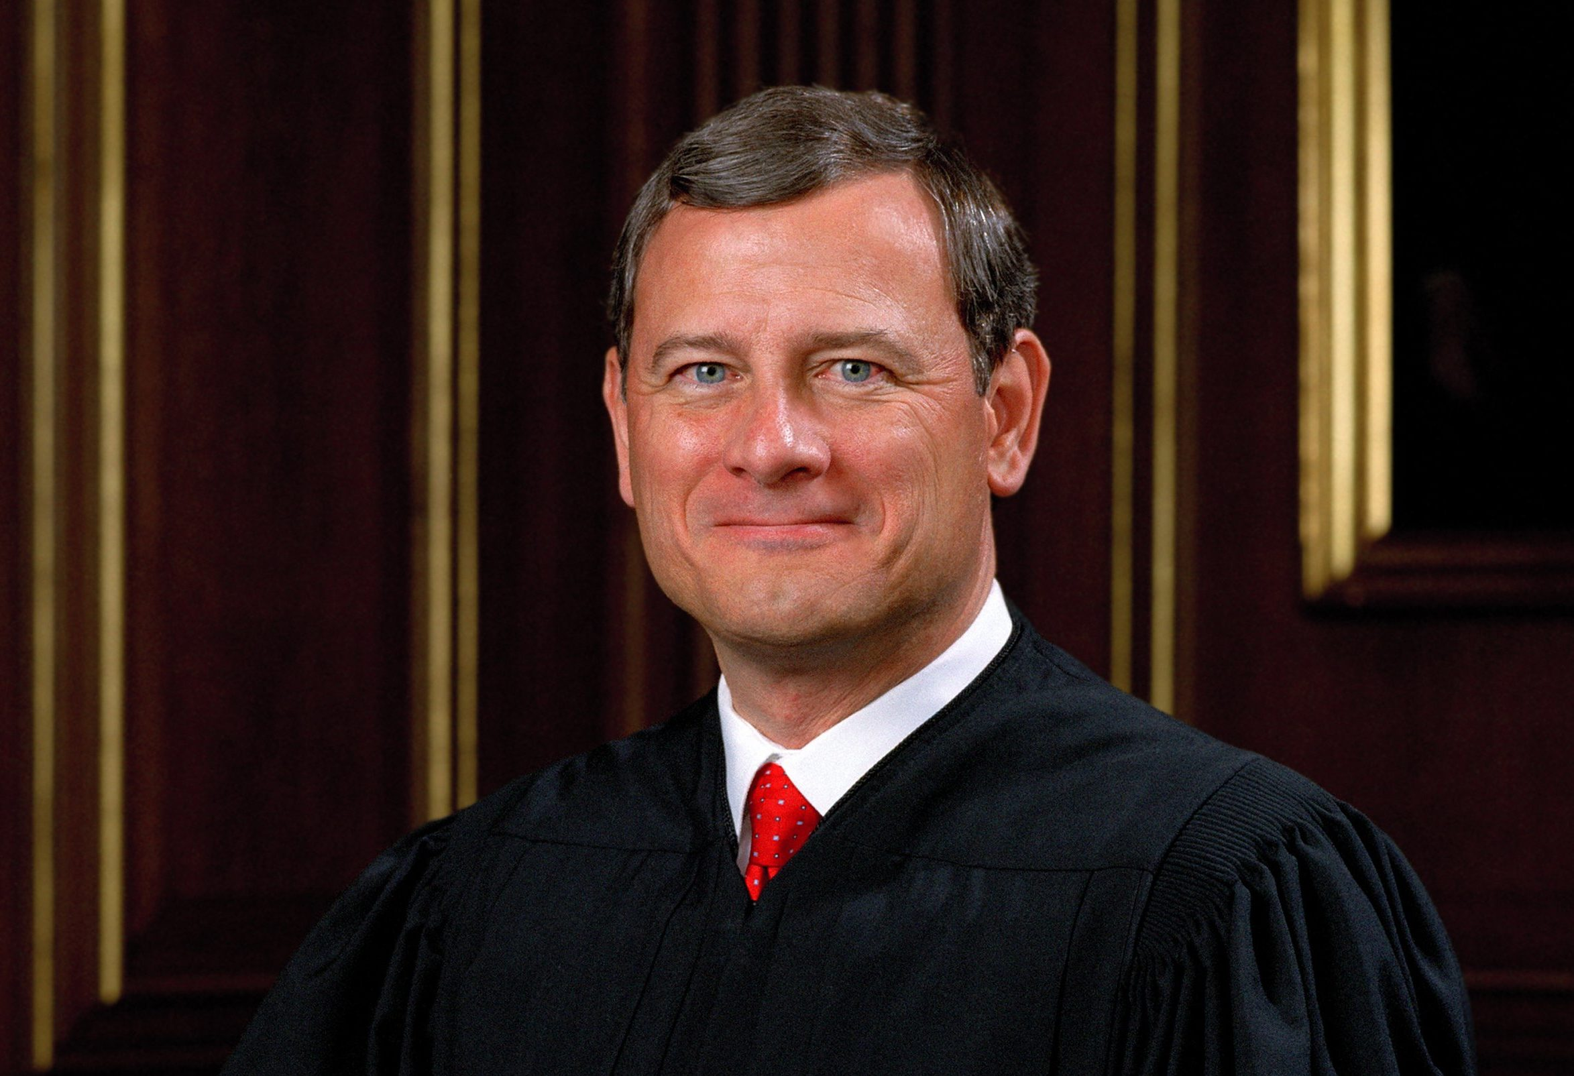
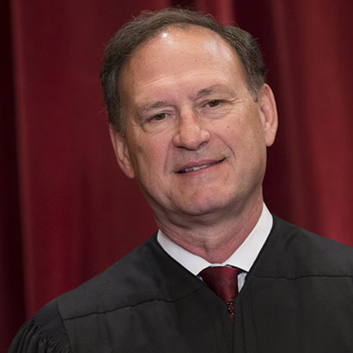
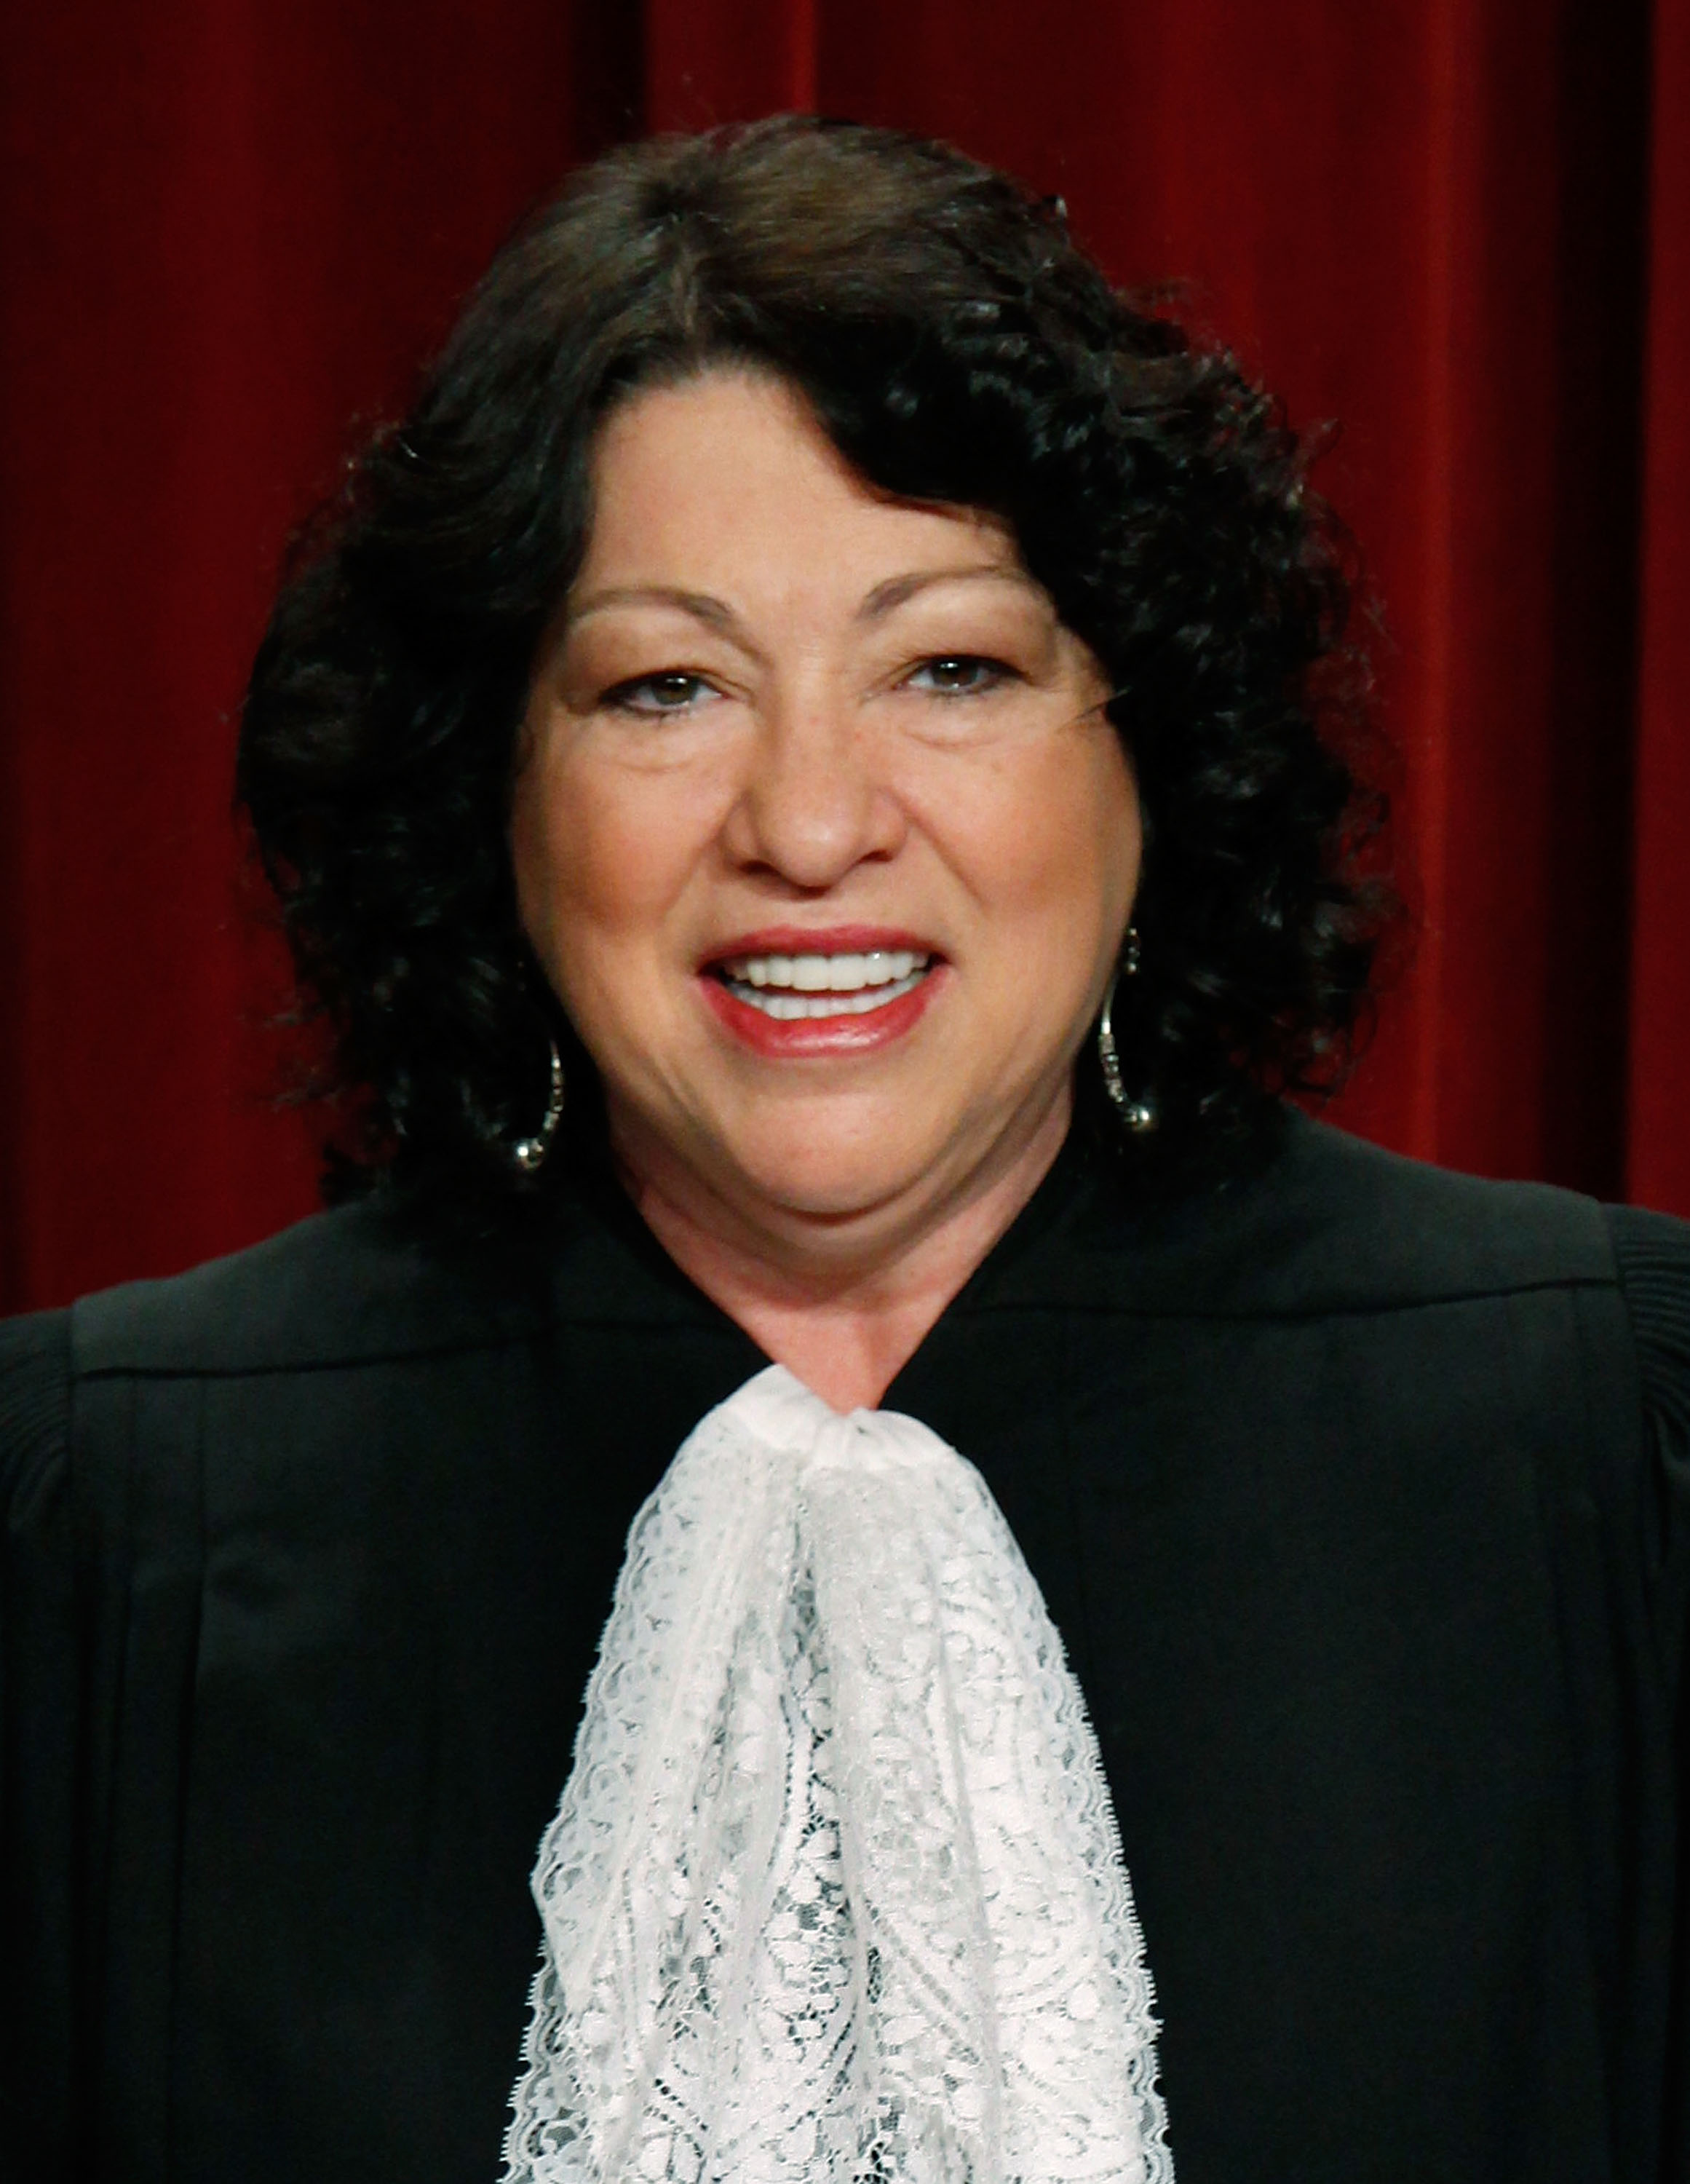
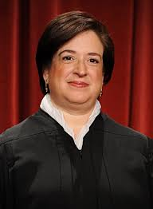
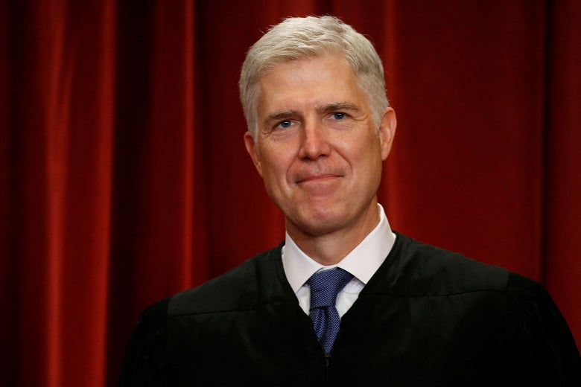
2017 Supreme Court of the United States
EQUAL JUSTICE UNDER LAW
Justice | Appointed | President Nominated | Constitutional Theory
Kennedy | 1987 | Ronald Regan | Non-Originalist
Scalia | 1986 | Ronald Regan | Originalist
Thomas | 1991 | George H. W. Bush | Originalist
Ginsburg | 1993 | Bill Clinton | Non-Originalist
Breyer | 1994 | Bill Clinton | Non-Originalist
Roberts | 2005 | George W. Bush | Non-Originalist
Alito | 2005 | George W. Bush | Practical Originalist
Sotomayor | 2009 | Barack Obama | Non-Originalist
Kegan | 2010 | Barack Obama | Non-Originalist
Gorsuch | 2017 | Donald Trump | Originalist

Slide 9
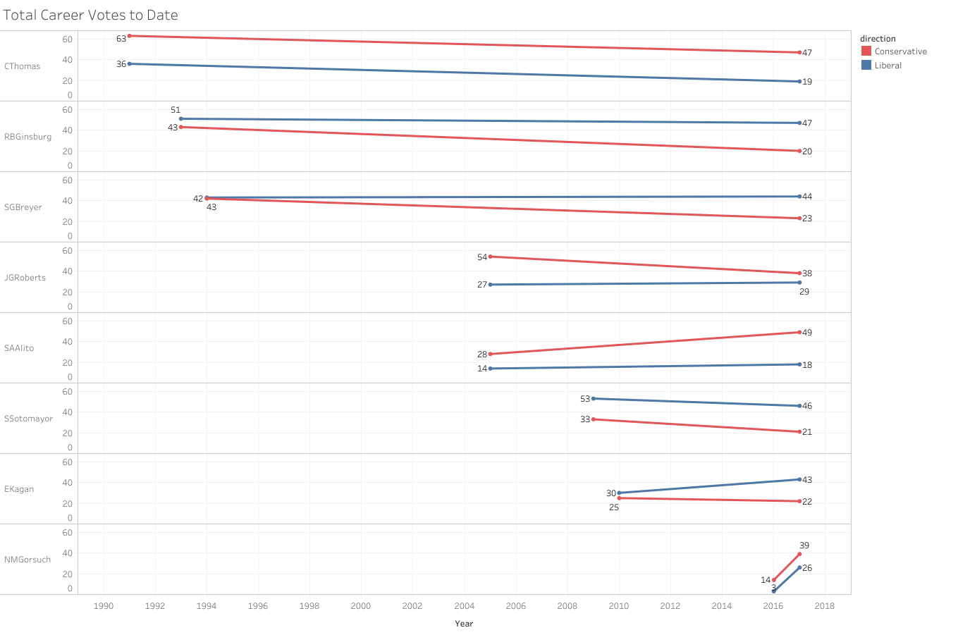
Polarity Over Time
The Justices with the most and least time on the bench (Thomas and Gorsuch respectively) have the least amount of deviation in their vote direction.
Only one Judge (Roberts) has become more centrist during their term.

Slide 10
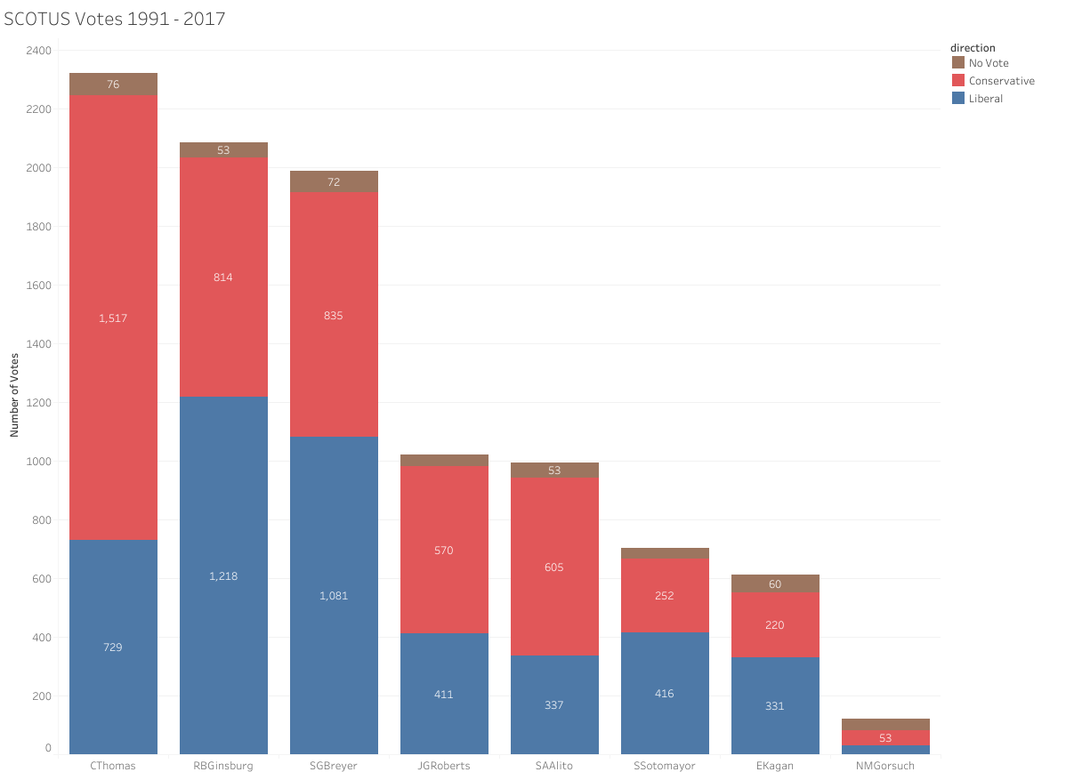
No Vote
Justices may not vote on a case for a number of reasons, but the most common is recusal.
Justice Kagan’s time as the Solicitor General for President Obama’s Justice Department caused her recuse herself from nearly 40 cases between 2005 - 2015.

